Slide 1
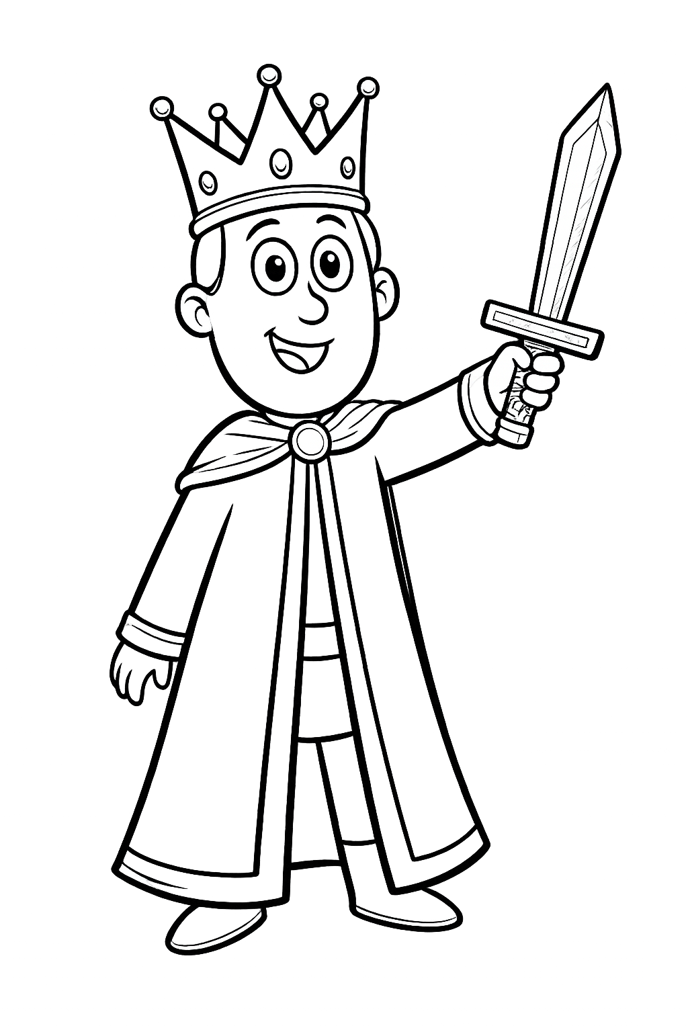
PRINCE LEO

Slide 2
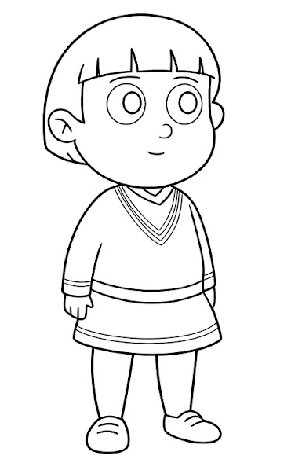
PRINCE GABE

Slide 3
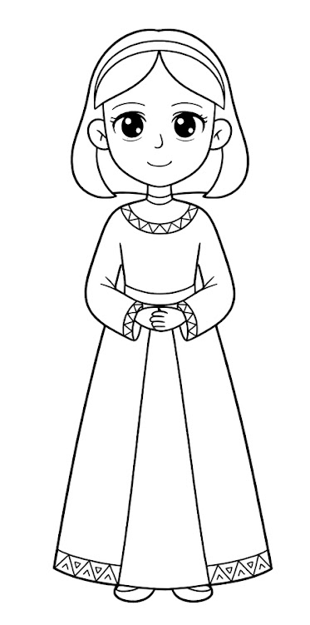
PRINCESS GINA

Slide 4
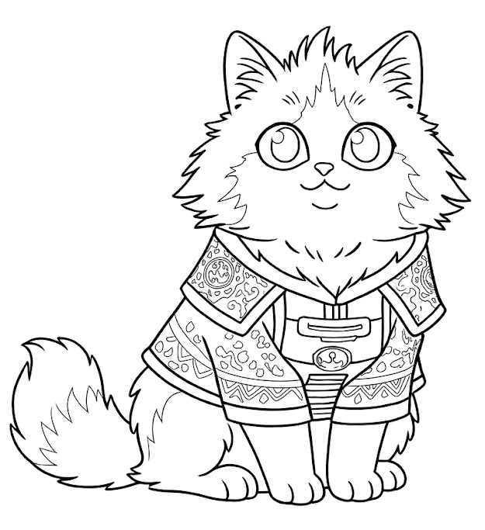
SIR FLUFINGTON

Slide 5
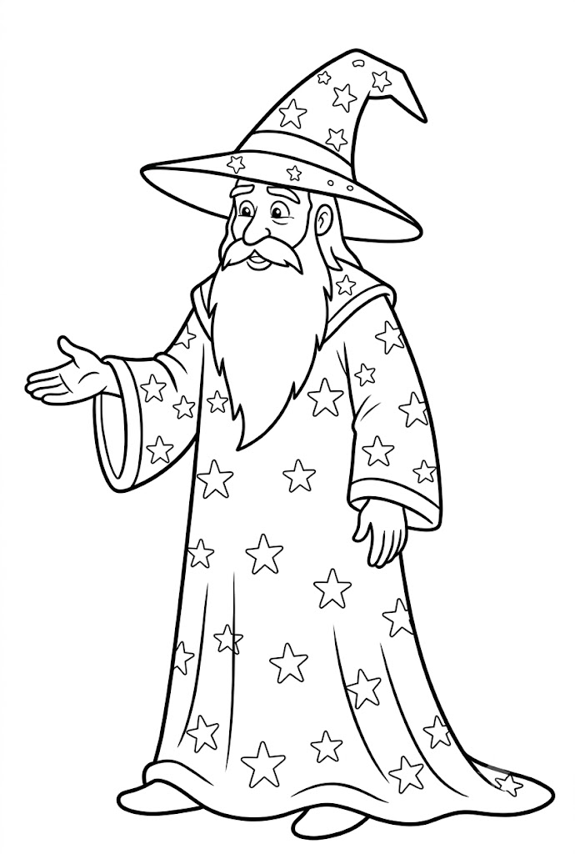
MERLIN THE WIZARD

